Slide 1





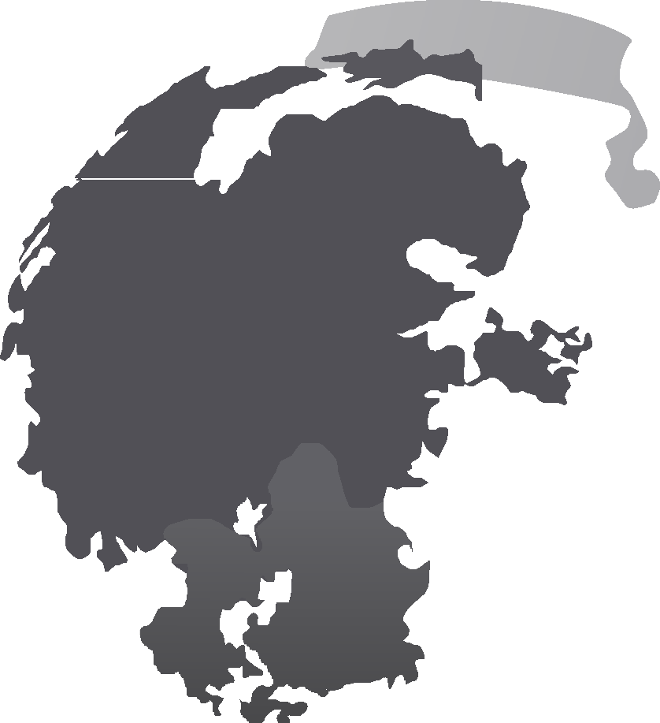








Detect Craters on Moon
Subhitcha S 20MIS1020 Bhavaa Dharshini 20MIS1031
Deepti Kannan 20MIS1061
Mohammed Aadil 20MIS1099

Slide 2

Literature Survey
AUTHORS AND PAPER TITLE | JOURNAL NAME | DESCRIPTION | RESULT
Craters Detection on Lunar Nur Diyana Kamarudin, Siti Noormiza Makhtar, Hizrin Dayana M.Hidzir Department of Electrical and Electronic Engineering, Faculty of Engineering, Universiti Pertahanan Nasional Malaysia, 57000 Kem Sg. Besi, Sg.Besi, Kuala Lumpur | Craters Detection on Lunar | This project focused on identification of craters in terms of its characteristics and detection of these visual features of the moon to determine a safe landing site for a lunar Lander. This paper had discussed the method of employing MATLAB and image processing tool on an optical image as well as the morphological image detection fundamentals. In addition, some geometrical projection analysis in reconstructing an ellipse as a disc will be evaluated in order to obtain the orientation of the disc (crater) for autonomous optical navigation system. | This paper focused primarily on identification and detection of craters on a lunar surface. To realize these goals, an algorithm to detect craters which are the main hazardous features on lunar is proposed. First, using the original image of craters on a moon surface, the author converts the RGB image plane to HSV image plane and analyzes only the Value parameter of a HSV plane. This output will then be used in ellipse reconstruction algorithm to get the orientation, of the disc (crater) from the camera projection. This is very useful information for the Lunar Lander as a first step before one can measure the position of the crater using the same algorithm.
Detecting Impact Craters in Planetary Images Using Machine Learning T. F. Stepinski¹, Wei Ding,² R. Vilalta³ ¹Dept. of Geography, Univ. of Cincinnati, OH 45221, USA. ²Dept. of Computer Science, Univ. of Massachusetts Boston, 100 Morrissey Blvd. Boston, MA 02125-339, USA. ³Dept. of Computer Science, University of Houston, 4800 Calhoun Rd., Houston, TX 77204, USA. | Detecting Impact Craters in Planetary Images Using Machine Learning | In this Paper ,they discussed two supervised machine learning techniques for crater detection algorithms (CDA): identification of craters from digital elevation models (also known as range images), and identification of craters from panchromatic images. The first class of methods rely exclusively on pattern recognition techniques to identify crater rims having circular or elliptical features in an image.They presented applications of both techniques and demonstrate how such automated analysis has produced new knowledge. | The algorithms presented here give reasonably accurate surveys of craters, but can benefit from better training sets. They suggest that the most important challenge of CDA is to incorporate elements of transfer learning and/or machine learning to allow for efficient addition of training samples as the need arises.

Slide 3
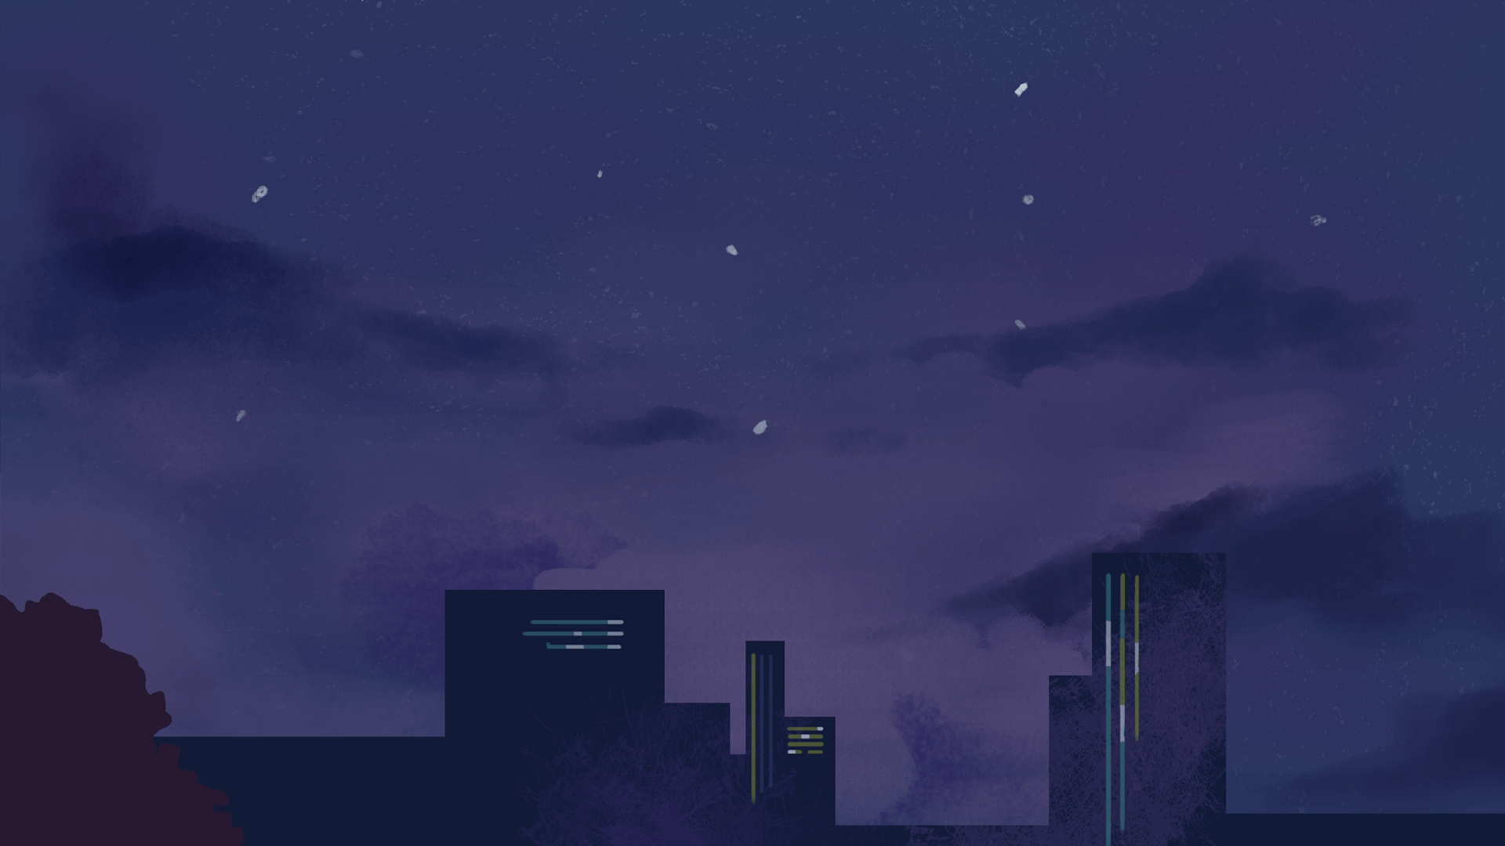
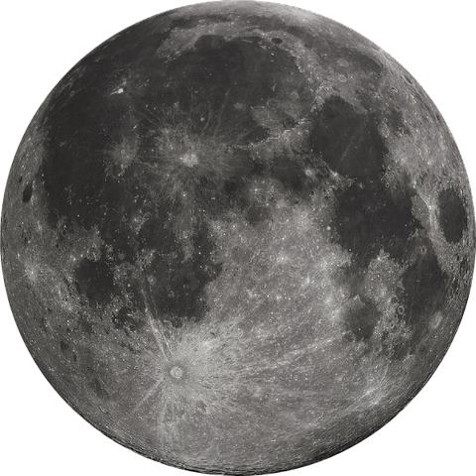
Introduction
To make the image clear we use image processing filters like 2D, image sharpening, and noise filters.
YOLO the architecture is splitting the input image in mxm grid.
For each grid generation 2 bounding boxes and class probabilities for those bounding boxes.

Slide 4

Methodology
We reframe object detection as a single regression problem, straight from image pixels to bounding box coordinates and class probabilities
We frame detection as a regression problem we don’t need a complex pipeline.
We simply run our neural network on a new image at test time to predict detections.

Slide 5
Techniques used
Image processing filters like 2D, image sharpening and noise filters
Python and its libraires like Matplotlib, NumPy, openCV, torch etc. for this project.
,
Google Colab IDE environment.
For Computer Vision we explored algorithms like YOLO

Slide 6
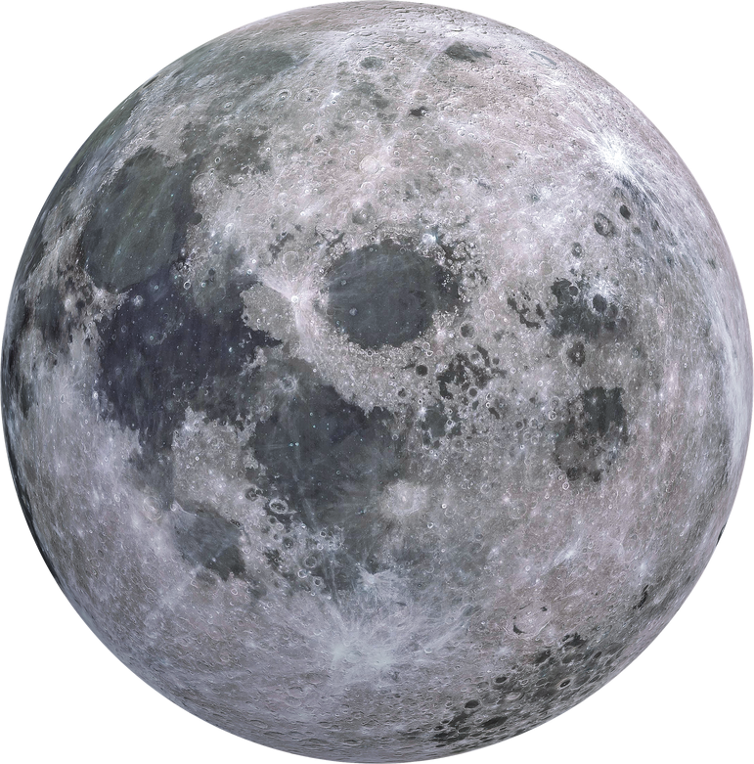

Image processing implementation
Reducing the noise for better recognization

Slide 7
YOLO Algo Implementation

Slide 8
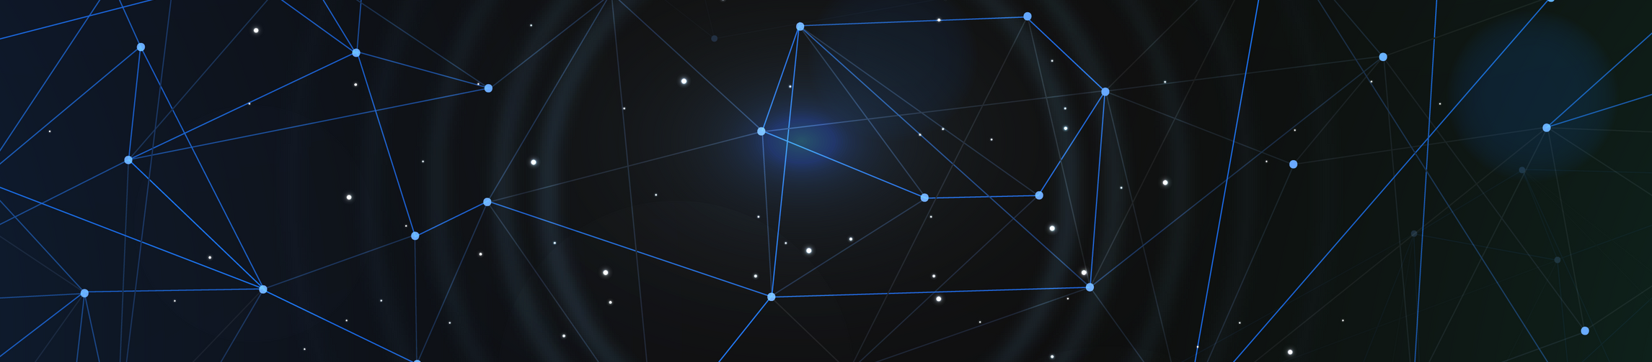
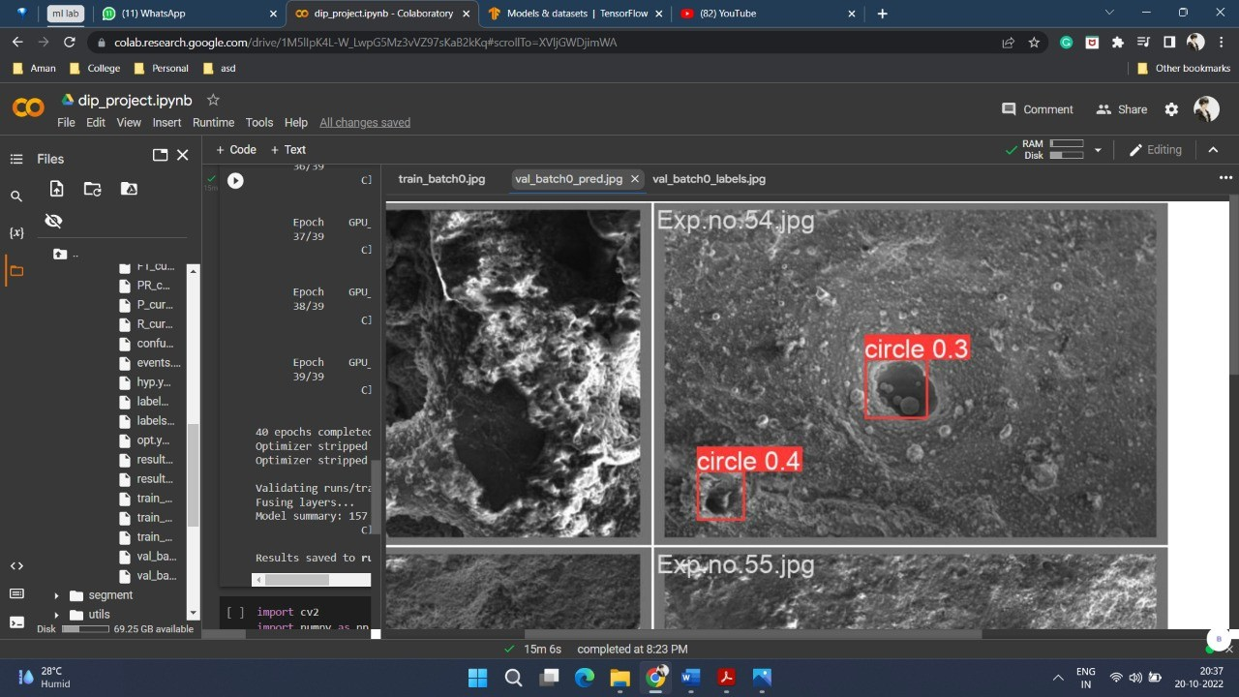

Slide 9

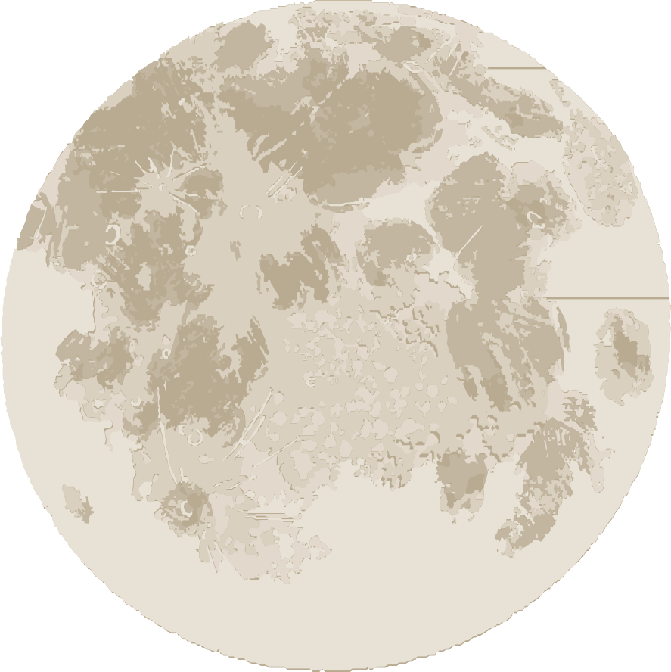
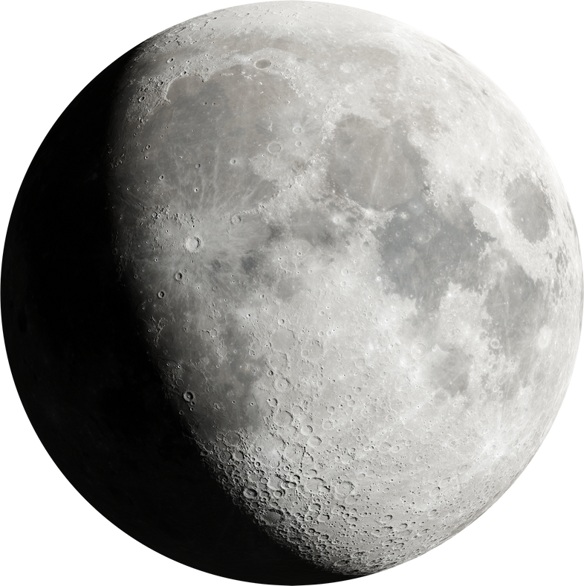
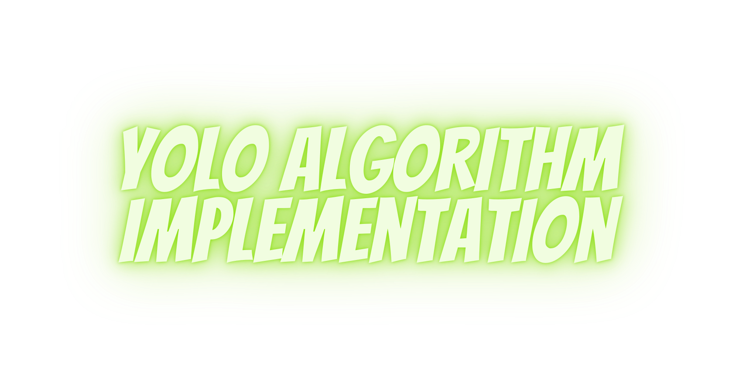



Slide 10
References
https://pytorch.org/hub/ultralytics_yolov5/#:~:text=YOLOv5%20%F0%9F%9A%80%20is%20a%20family,Model
https://github.com/ultralytics/yolov53.
https://towardsdatascience.com/the-practicalguide-for-object-detection-with-yolov5algorithm-74c04aac4843
https://medium.com/axinc-ai/yolov5-thelatest-model-for-object-detectionb13320ec516b
https://www.makesense.ai/

Slide 11



